Slide 1

TOXYScreen
THE CERTIFIED ORAL FLUID COLLECTION PROCESS IS THE SOLUTION
Notes:
OPENING SLIDE

Slide 2
WHERE DOES LEAD COME FROM
Lead has been found in paint, window blinds, pottery, cosmetics, children’s toys, candy/gum, lead bullets, canned food, and most recently, baby food.
Exposure to lead can also come from lead- contaminated dust, water, and soil, as well as brought home on clothing by adults that work with batteries, auto repair or home renovations.

Slide 3
Lead Effects Both Children and Adults
Of the 1.1 million U.S. children under age 6 who were tested, half (50.5 percent) had detectable levels of blood lead (1.0 microgram per deciliter or higher). And almost 2 percent had elevated levels considered to be a risk to health (5.0 µg/dL or higher). new study published in the peer-reviewed journal JAMA Pediatrics Lead Contamination Found in Blood of Half of Young Kids in US
The Number of Children with Lead Poisoning May be about to more than Double Centers for Disease Control and Prevention means the number of children ages 1 to 5 considered to have high blood lead levels will grow from about 200,000 to about 500,000 Associated Press Oct 20, 2021
1.4 million children in the United States have lead poisoning
Although children are primarily at risk, lead poisoning is also dangerous for adults. Researchers concluded that nearly 412,000 deaths every year in the US can be attributed to lead contamination

Slide 4
EFFECTS OF LEAD EXPOSURE ON CHILDREN
Damage to the brain and nervous system
Slowed growth and development
Learning and behavior problems
Hearing and speech problems
Lower IQ
Decreased ability to pay attention
Underperformance in school

Slide 5
SYMPTONS OF ELAVATED BLOOD LEVELS IN CHILDREN
Developmental delays
Learning difficulties
Irritability
Seizures
Fatigue
Abdominal pain, vomiting, constipation
Weight loss, loss of appetite
Eating things that are not food (pica)

Slide 6
EFFECTS OF LEAD EXPOSURE ADULTS
High blood pressure
Joint and muscle pain
Difficulties with memory or concentration
Headache
Abdominal pain
Mood disorders
Reduced sperm count and abnormal sperm
Miscarriage, stillbirth or premature birth in pregnant women

Slide 7
SYMPTONS OF ELAVATED BLOOD LEVELS IN ADULTS
High Blood Pressure
Joint and muscle pain
Memory or concentration difficulties
Mood disorders
Headaches
Abdominal pain
Miscarriages or stillbirths

Slide 8
CDC CHANGED DANGER OF LEAD EXPOSURE SEVERAL TIMES
In the 1970’s – the max level for children ages 1 to 5 was 15 ug/dl.
1991 it was reduced to 10 ug/dl.
Oct 28, 2021 — In 2012, it was reduced to 5 micrograms. The new standard announced 2021 is 3.5 micrograms
Any exposure, even at low levels, can cause damage over time.
In children, prolonged lead exposure can cause irreversible damage, with greater risk to brain development.
High lead levels can damage kidneys and nervous systems in both children and adults.

Slide 9
THE SOLUTION TO WHY SO MANY CHILDREN MANDATED BY LAW TO GET TESTED FOR LEAD AREN’T BEING TESTED
HOW MANY CHILDREN ARE THERE WITH LEAD POISINING ISSUES IN THE UNITED STATES ?
WE REALLY DON’T KNOW !!!!!
If you don’t test, you never really know,” said Joel Schwartz, an epidemiologist at Harvard University’s school of public health. “You might think you don’t have a problem, and you might be wrong.”
NO COMPREHENSIVE TESTING, NO IDEA HOW MUCH OF A PROBLEM THERE IS
Notes:
OPENING SLIDE

Slide 10
WHAT DO WE KNOW ABOUT STATE LEAD TESTING MANDATES AND THEIR RESULTS
MANDATES
Blood lead tests are mandated for all children in 11 U.S. states and Washington, DC. In addition, Medicaid requires that the one-third of all U.S. children enrolled in the program, which provides health care for low-income and disabled people, be tested at ages one and two. Some other states mandate tests for all children in areas with exposure risks, such as housing with lead paint or lead-tainted soil.
RESULTS
In a review of data in nearly a dozen U.S. states, Reuters found just 41 percent of Medicaid-enrolled one- and two-year-olds had been tested as required. And in some states requiring tests, more than half the children were missing a test.
LESS THAN HALF OF THE CHILDREN NEEDING TESTING ARE GETTING TESTED

Slide 11
Many states and Medicaid rules require blood lead tests for young children, but millions are falling through this safety net, leaving them vulnerable to poisoning ………..WHY……..
DIFFICULT TO GET CHILDREN THAT NEED TO BE TESTED TO THE FACILITIES THAT OFFER TESTING….DISTANCE….TRAVEL……TIME…..UNDERSTANDING
INVASIVE …CREATES FEAR AND ANXIETY JALM SURVEY IDENTIFIED 68% OF CHILDREN AFRAID WITH STRESS AND ANXIETY OF BLOOD DRAW AND 63% OF PARENTS.. ADDITIONAL ISSUES INCLUDE OF FINDING VEINS,,,FINGER TIP ISSUES…..HEAL OF INFANT (DERMAL Puncture)
MEDICAL WASTE …SYRINGES,NEEDLES, BLOOD VIALS, BANDAGES OR DRESSINGS WITH BLOOD STAINS …ALL WASTE MUST BE DISCARDED BY SPECIALIZED MEANS CREATING HIGHER COST
NEED SKILLED TECHNICIAN FOR PROCESS
HIGHER RISK OF INFECTION OR CROSS CONTAMINATION
INTEGRITY OF SAMPLES BASED ON HANDLING AND TESTING PROCEDURES

Slide 12
WHY TOXYScreen IS THE SOLUTION
NON-INVASIVE EASE OF COLLECTION….. SCREENING CAN BE PERFORMED ANYWHERE, SCHOOLS, RECREATION CENTERS, OUTDOORS ……anywhere!!!!
NO SPECIACIZED SKILLLS FOR COLLECTION
ELIMINATION OF FEAR AND ANXIETY……
NO NEEDLES, NO MEDICAL WASTE NEEDING SPECIAL HANDLING FOR DISGARDING,
LOWER COST OF SAMPLE COLLECTION
REDUCED RISK OF INFECTION OR CROSS CONTAMINATION
SAMPLE INTEGRITY SHIPPING SECURE CONTAINER SHELF LIFE 1 YEAR

Slide 13
WHAT ABOUT ACCURACY ?
BLOOD 94.7%
TOXYScreen 99.1%

Slide 14
BENEFITS OF THE TOXYScreen SOLUTION
SCREENING CAN GO TO THE DONORS ….NO RESTRICTIONS
EASE OF COLLECTION
COST EFFECTIVE
MORE ACCURATE

Slide 15
Testing Value History
In the 1970’s – the max level for children ages 1 to 5 was 15 ug/dl.
1991 it was reduced to 10 ug/dl.
2012 it was reduced to 5 ug/dl.
October 2021,the standard became 3.5 ug/dl, after continued scientific evidence shows that any small amounts of lead can affect intellectual development.

Slide 16
TOXYScreen SCREENING
Components and Steps of the CCF
or
Custody Control Form

Slide 17
Oral Fluids Testing Process
Components and Steps of the Custody Control Form (CCF)
Requisition Form
Sample Collection Instructions
Packaging and Mailing of Samples
Reporting of Results

Slide 18
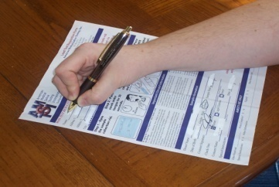
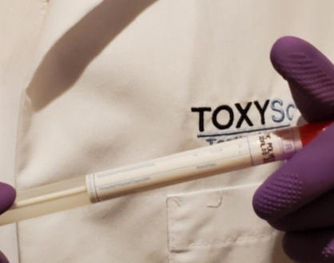
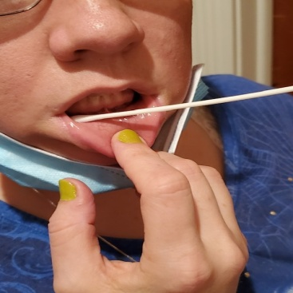
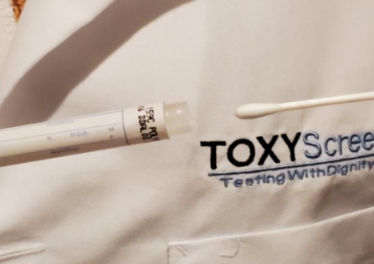
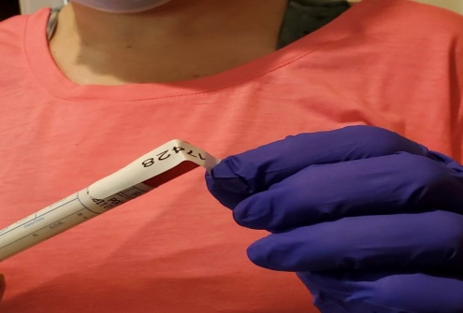
Sample Collection Instruction
STEP 1:
Fill out Requisition Form (CCF)
Sample Information – Donors name, Date of Birth, Gender, Sample Date, Consent Signature if Donor under 18 yrs of age
STEP 2
Open packaging containing Oral Fluid Specimen Kit
STEP 3
Place the end of specimen kit into the well of the mouth between the teeth and lips -- this is the location in the mouth to gather oral fluids
Move swab gently from back to front of mouth along the gum line for 15 to 30 seconds
STEP 4
Place swab back into sterile tube and secure cap
1
2
3
4
STEP 5
There are two (2) evidence seals with kit.
Place one (1) tamper evidence seal on specimen container and one (1) on the requisition form.
5

Slide 19

Step 1: Requisition Form (CCF)
INFORMATION REQUIRED:
Donor’s Social Security Number
Physician Name
Physician Address
Reason for Test
Type of Test
Collected by
Date of Collection
Time of Collection

Slide 20
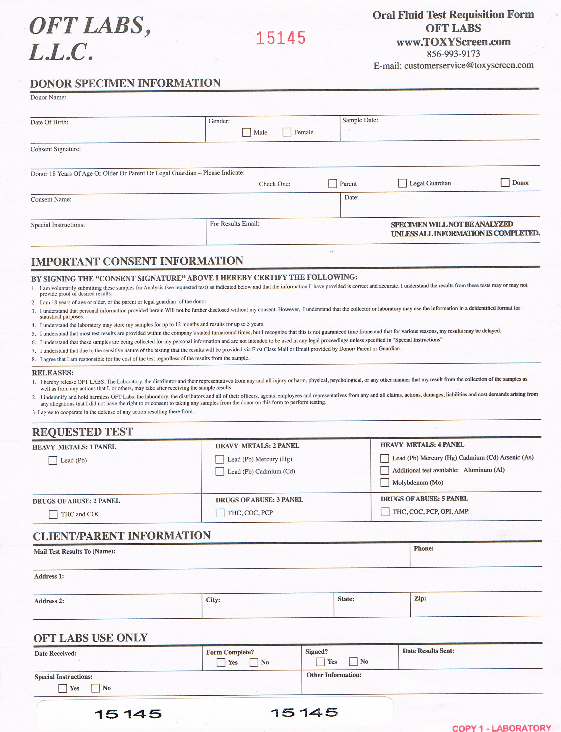
Step 1: Requisition Form (CCF)

Slide 21
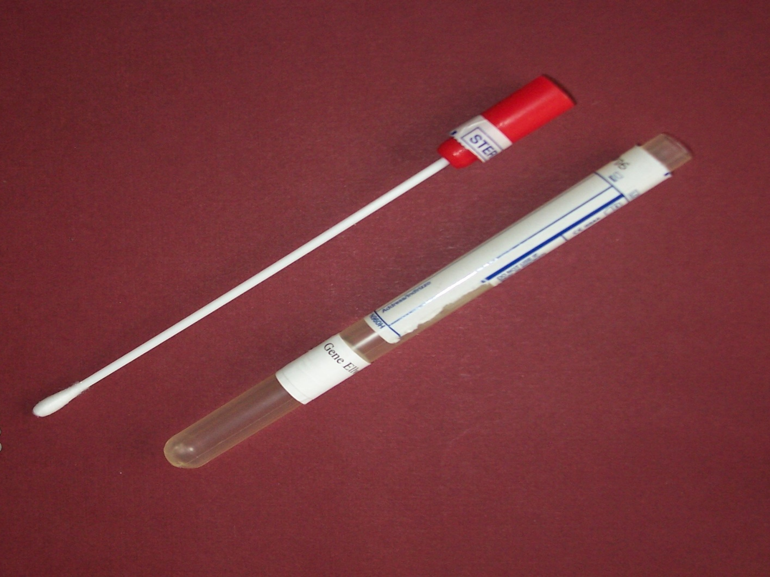
Step 2 Open: Oral Fluid swab (Dacron)

Slide 22
Step 3 :Explain to Donor or Parent How Test will be Administered
Place the end of specimen kit into the well of the mouth between the teeth and lips -- this is the location in the mouth to gather oral fluids
Move swab gently from back to front of mouth along the gum line for 15 to 30 seconds

Slide 23
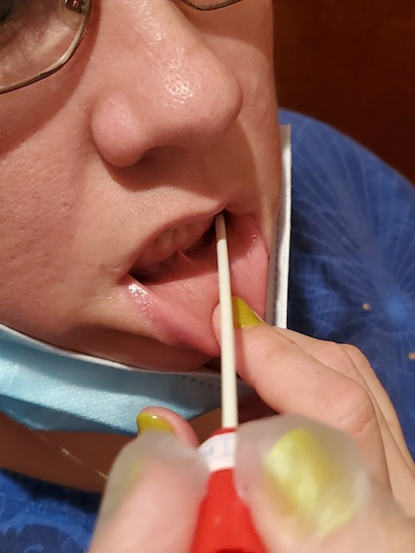

Step 3: Place swab between lip & gum moving from front to back, left to right for 15-30 seconds.

Slide 24

Step 4: Place specimen swab back in sterile tube

Slide 25
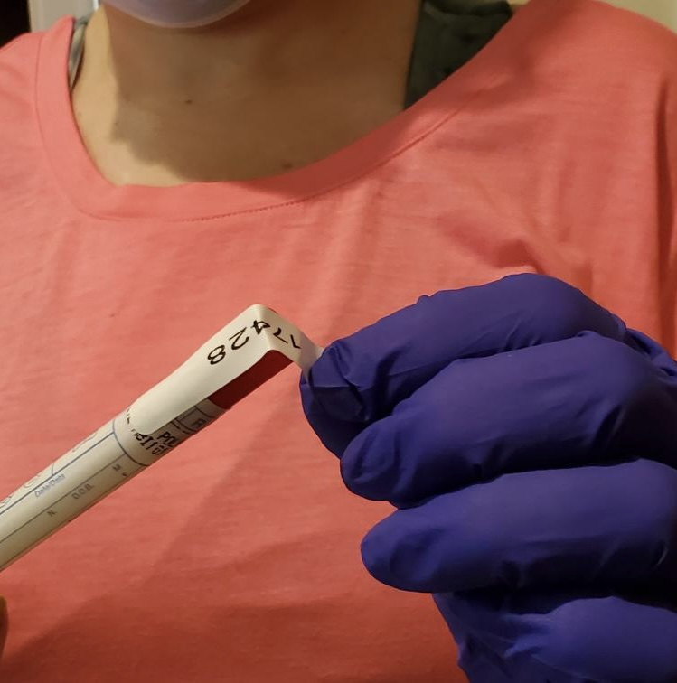
Step 5: Apply Specimen Seal Located Bottom of Acquisition Form
Apply Specimen Seal

Slide 26
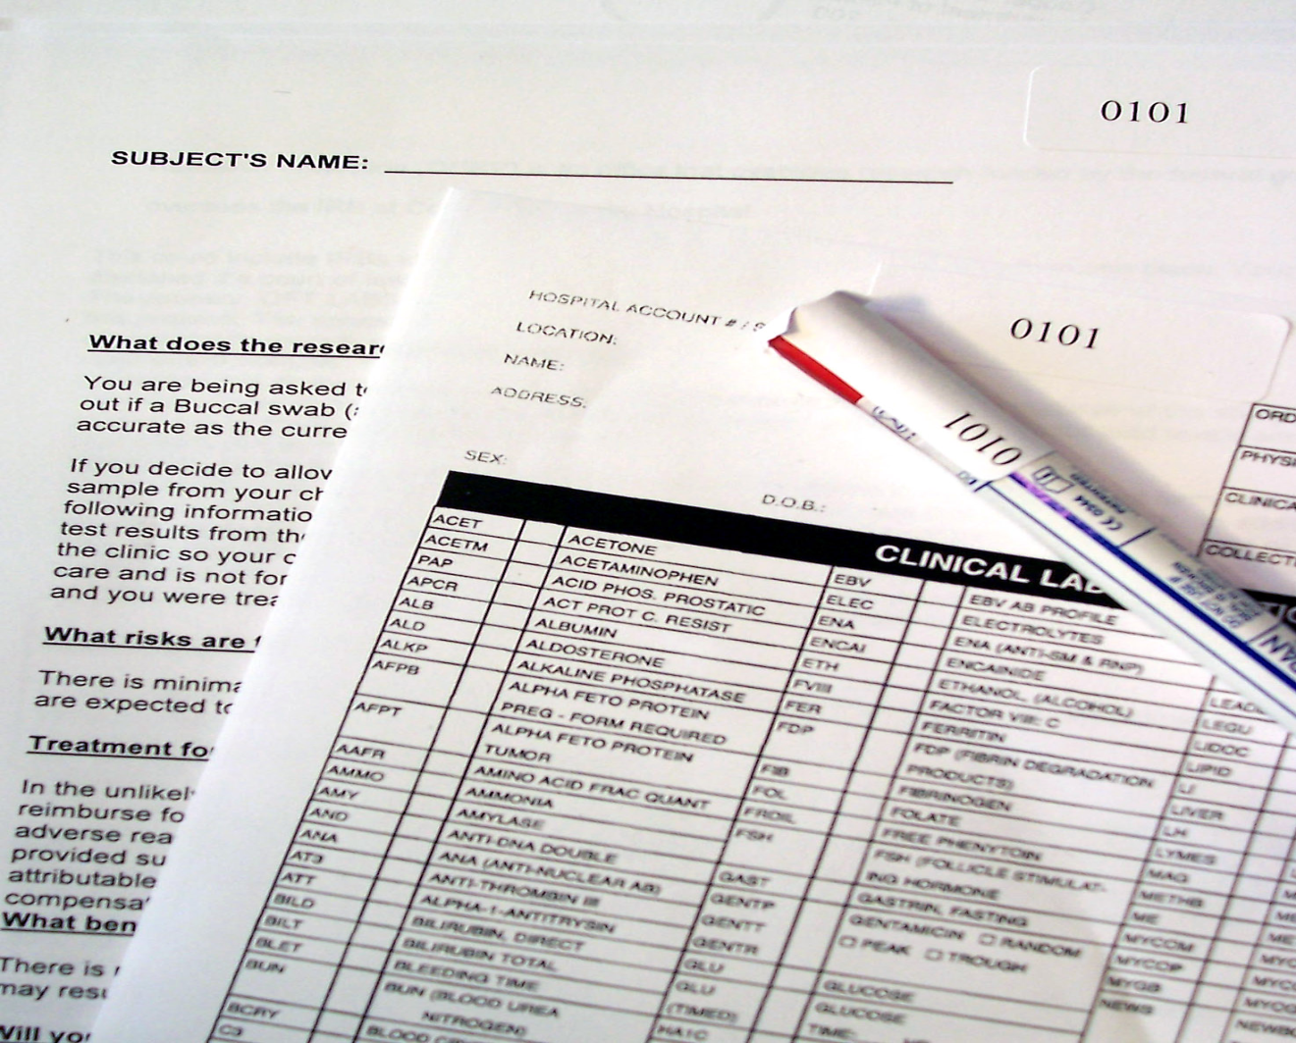
Step 5: Requisition (CCF) and specimen to be labeled with corresponding numbers.
Place corresponding number labels on each form and specimen swab

Slide 27
Completing the Testing Process
Complete the chain of custody on the CCF with the following information:
Collector - prints name.
Record the time and date of collection
Sign the CCF (Three Copy Form)
Original first page goes with sample to lab
Copy to donor/guardian, and clinic retains final copy.
Completed sample(s) and CCF are sent to the designated lab via next day air.

Slide 28
Supplies For Shipping To Lab
All Testing Sites Will Receive Pre-Paid Shipping Envelopes & Supplies (Number of Supplies Will be based on Anticipated Volume of Test)
Brown Master UPS Lab Specimen Shipping Bag
White padded/cushioned Shipping envelope
Ten Samples per White Envelope, a Total of Three(3) White Envelopes per Pre-Paid Brown Master for a Total of Thirty (30) Samples
ALL Requisition Forms with the matching Patient Information as marked on each specimen Vial will sent in the Brown Master Specimen Bag And Sent Via UPS

Slide 29
Reporting Of Lead Test Results
ALL Donors Tested will Receive Results
Donors with Test In Excess of the 3.5 Micrograms will be notified along with the Primary Care Doctor of the Donor for Treatment
Both the Federal and State Departments of Health mandated to Record Lead testing Levels will be Notified

Slide 30
CLEAR ADVANTAGES OF TOXYScreen
HAVE LEAD SCREENING GO TO THE DONORS' SITES
SET UP LEAD SCREENING CONVENIENT TO ALL DONORS
REDUCE MEDICAL WASTE
EASE OF TEST FOR ADMINISTERS
THE SAMPLE INTEGRITY ADVANTAGE Handling & Shelf Life
ELIMINATION OF FEAR AND ANXIETY……
NO NEEDLES, NO MEDICAL WASTE NEEDING SPECIAL HANDLING FOR DISGARDING,
LOWER COST OF SAMPLE COLLECTION
REDUCED RISK OF INFECTION OR CROSS CONTAMINATION
THE END

Slide 31
“GET THE LEAD OUT”
LET'S WORK TOGETHER TO IDENTIFY ALL CHILDREN IN NEED OF LEAD SCREENING AND DIRECT THE CHILDREN AT UNACCEPTABLE LEVELS TO EVALUATE THEIR ENVIROMENT AND SEEK MEDICAL ATTENTION TO ELIMINATE
“LEAD”

Slide 32
“GET THE LEAD OUT”
OFT LABS
TOXYScreen
THANK YOU

